Slide 1


Slide 2
Founded in 1991, Accusoft is a software development company specializing in content processing, conversion, and automation solutions.

Slide 3
Mission & Vision
Our mission is to make the world in which we live and work a better place. We do this by inventing new ways to help organizations become more efficient and innovative, promoting the continuous improvement of our community, and working to minimize our impact on natural resources.
Our vision is to transform the way organizations interact with content by providing software that solves complex workflow challenges, improves productivity, provides actionable data, and delivers results that matter.

Slide 4





Giving Back

Slide 5



Dedication to Continuous Innovation
New Version Release
Customer-Centric Product Development
Passion for Understanding Industry Trends that Drive Consumer Demand

Slide 6
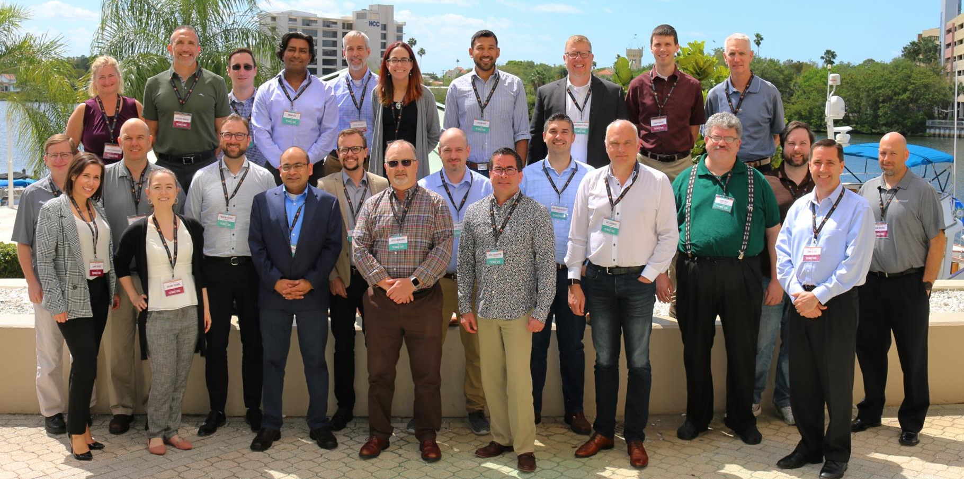
Customer Advisory Board: The Board of Connectors

Slide 7

accusoft.com | +1 800.875.7009
Presentation Title
Presenter Name

